Slide 1
Selenium with Python

Slide 2
What is Selenium?
Selenium is an open-source web-based automation tool.
Permit it to tap on buttons
Enter content in structures
Skim your site to check whether everything is "OK" and so on.
Official Website : https://www.seleniumhq.org/
For more reading on Selenium with Pyhon:
https://selenium-python.readthedocs.io/

Slide 3
Install and Configure
Make sure PyDev is installed
Install Selenium Package
Download Webdriver like; Chrome

Slide 4
Example Code
from selenium import webdriver
from selenium.webdriver.common.keys import Keys
driver = webdriver.Chrome(executable_path=“”) driver.get("http://www.python.org")
assert "Python" in driver.title
elem = driver.find_element_by_name("q")
elem.clear()
elem.send_keys("pycon") elem.send_keys(Keys.RETURN)
assert "No results found." not in driver.page_source driver.close()

Slide 5
Exercise
Write Script for Facebook login

Slide 6
Navigating a Web Page
driver.get("http://www.google.com")
Interacting with the page
Filling in forms¶
<input type="text" name="passwd" id="passwd-id" />
We can find using:
element = driver.find_element_by_id("passwd-id") element = driver.find_element_by_name("passwd") element = driver.find_element_by_xpath("//input[@id='passwd-id']")
Cookies
driver.get("http://www.example.com")
# Now set the cookie. This one's valid for the entire domain
cookie = {‘name’ : ‘foo’, ‘value’ : ‘bar’}
driver.add_cookie(cookie)
# And now output all the available cookies for the current URL driver.get_cookies()

Slide 7
Locating Elements
Selenium provides the following methods to locate elements in a page:
find_element_by_id
find_element_by_name
find_element_by_xpath
find_element_by_link_text
find_element_by_partial_link_text
find_element_by_tag_name
find_element_by_class_name
find_element_by_css_selector

Slide 8
To find multiple elements (these methods will return a list):
find_elements_by_name
find_elements_by_xpath
find_elements_by_link_text
find_elements_by_partial_link_text
find_elements_by_tag_name
find_elements_by_class_name
find_elements_by_css_selector

Slide 9
Locating by XPath¶
<html>
<body>
<form id="loginForm">
<input name="username" type="text" />
<input name="password" type="password" /> <input name="continue" type="submit" value="Login" />
<input name="continue" type="button" value="Clear" />
</form>
</body>
<html>
Locate form:
login_form = driver.find_element_by_xpath("/html/body/form[1]") login_form = driver.find_element_by_xpath("//form[1]") login_form = driver.find_element_by_xpath("//form[@id='loginForm']")

Slide 10
Locating by XPath
Locate Username :
username = driver.find_element_by_xpath("//form[input/@name='username']")
username = driver.find_element_by_xpath("//form[@id='loginForm']/input[1]")
username = driver.find_element_by_xpath("//input[@name='username']")
Locate Button:
clear_button = driver.find_element_by_xpath("//input[@name='continue'][@type='button']") clear_button = driver.find_element_by_xpath("//form[@id='loginForm']/input[4]")

Slide 11
Locating Hyperlinks by Link Text
<html>
<body>
<p>Are you sure you want to do this?</p>
<a href="continue.html">Continue</a>
<a href="cancel.html">Cancel</a>
</body>
<html>
continue_link = driver.find_element_by_link_text('Continue') continue_link = driver.find_element_by_partial_link_text('Conti')

Slide 12
Locating Elements by Class Name
<html>
<body>
<p class="content">Site content goes here.</p> </body>
<html>
content = driver.find_element_by_class_name('content')

Slide 13
Locating Elements by CSS Selectors
<html>
<body>
<p class="content">Site content goes here.</p>
</body>
<html>
content = driver.find_element_by_css_selector('p.content')

Slide 14
Unittest framework

Slide 15
Choosing a Test Runner in Python
The three most popular test runners are:
unittest
nose or nose2
pytest
Unittest:
unittest has been built into the Python standard library
unittest contains both a testing framework and a test runner

Slide 16
unittest
unittest requires that:
You put your tests into classes as methods
Example:
import unittest
class TestSum(unittest.TestCase):
def test_sum(self):
self.assertEqual(sum([1, 2, 3]), 6, "Should be 6") def test_sum_tuple(self):
self.assertEqual(sum((1, 2, 2)), 6, "Should be 6")
if __name__ == '__main__':
unittest.main()

Slide 17
OOP concepts supported by unittest framework:
test fixture: A test fixture is used as a baseline for running tests to ensure that there is a fixed environment in which tests are run so that results are repeatable. Examples :
creating temporary databases.
starting a server process.
test case: A test case is a set of conditions which is used to determine whether a system under test works correctly.
test suite: Test suite is a collection of testcases that are used to test a software program to show that it has some specified set of behaviours by executing the aggregated tests together.
test runner: A test runner is a component which set up the execution of tests and provides the outcome to the user.

Slide 18
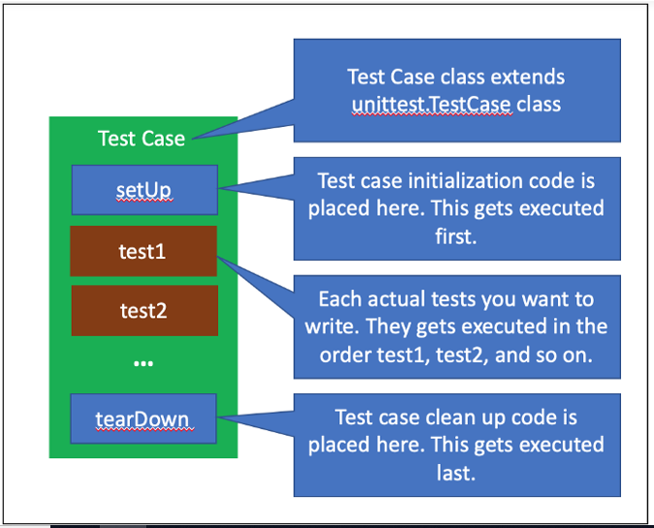
Unittest Structure

Slide 19
Assertion
Method | Assertion
assertEqual(a,b) | a == b
assertNotEqual(a,b) | a != b
assertIsNone(x) | x is None
assertIsNotNone(x) | x is not None
assertIn(a,b) | a in b
assertNotIn(a,b) | a not in b
assertIsInstance(a,b) | isinstance(a,b)
assertNotIsInstance(a,b) | not isinstance(a,b)

